Slide 1
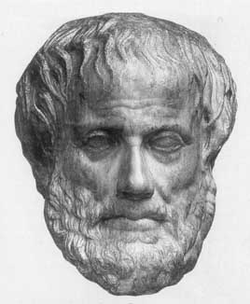
Lecture 1
Characterisations of AI
Junfeng Yao
Xiamen University
Slides used in the classroom only

Slide 2
Lecture overview
Artificial Intelligence
1. Characterisations of AI

Slide 3
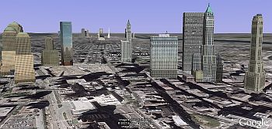
Can machines recognize an image? Be able to see!

Slide 4
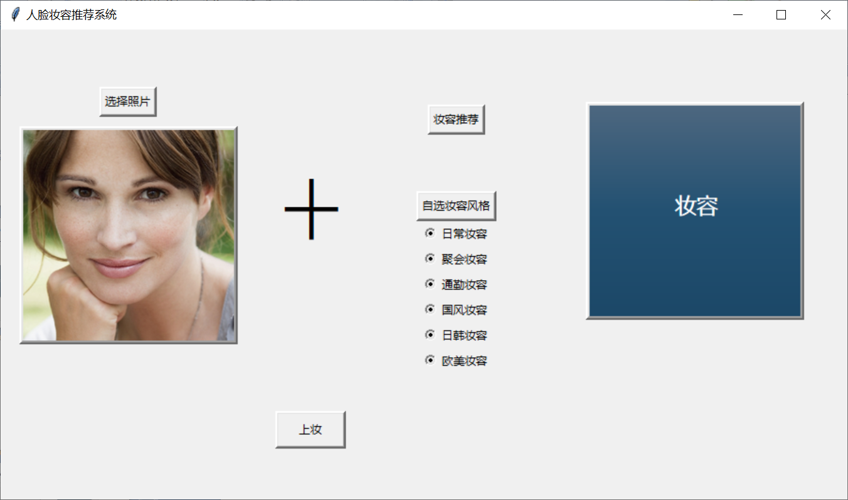
Choose one picture that is not made up：

Slide 5
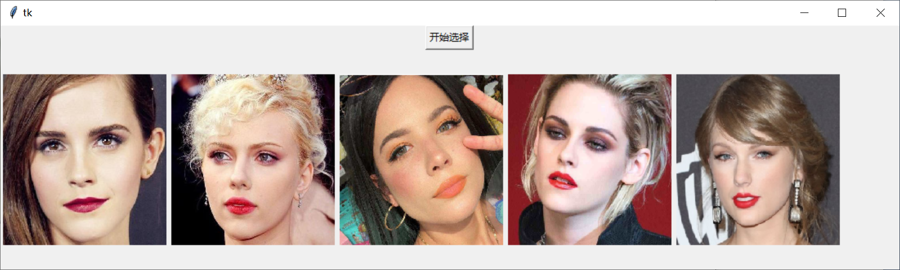
Chose one type of makeup：
All the options for this style of makeup will be displayed.

Slide 6
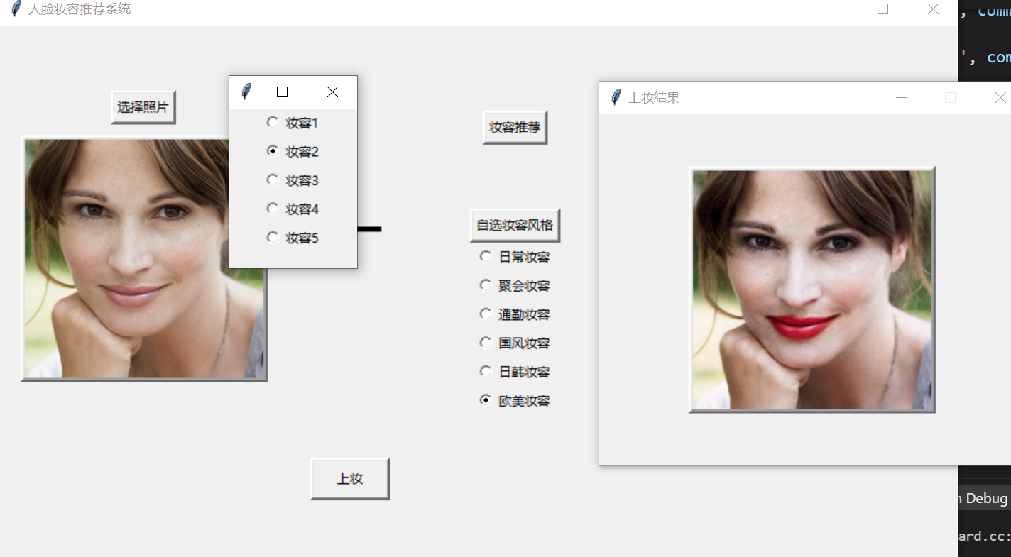
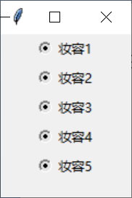
Choose the makeup you want to apply，and you can see the picture that has been made up:

Slide 7
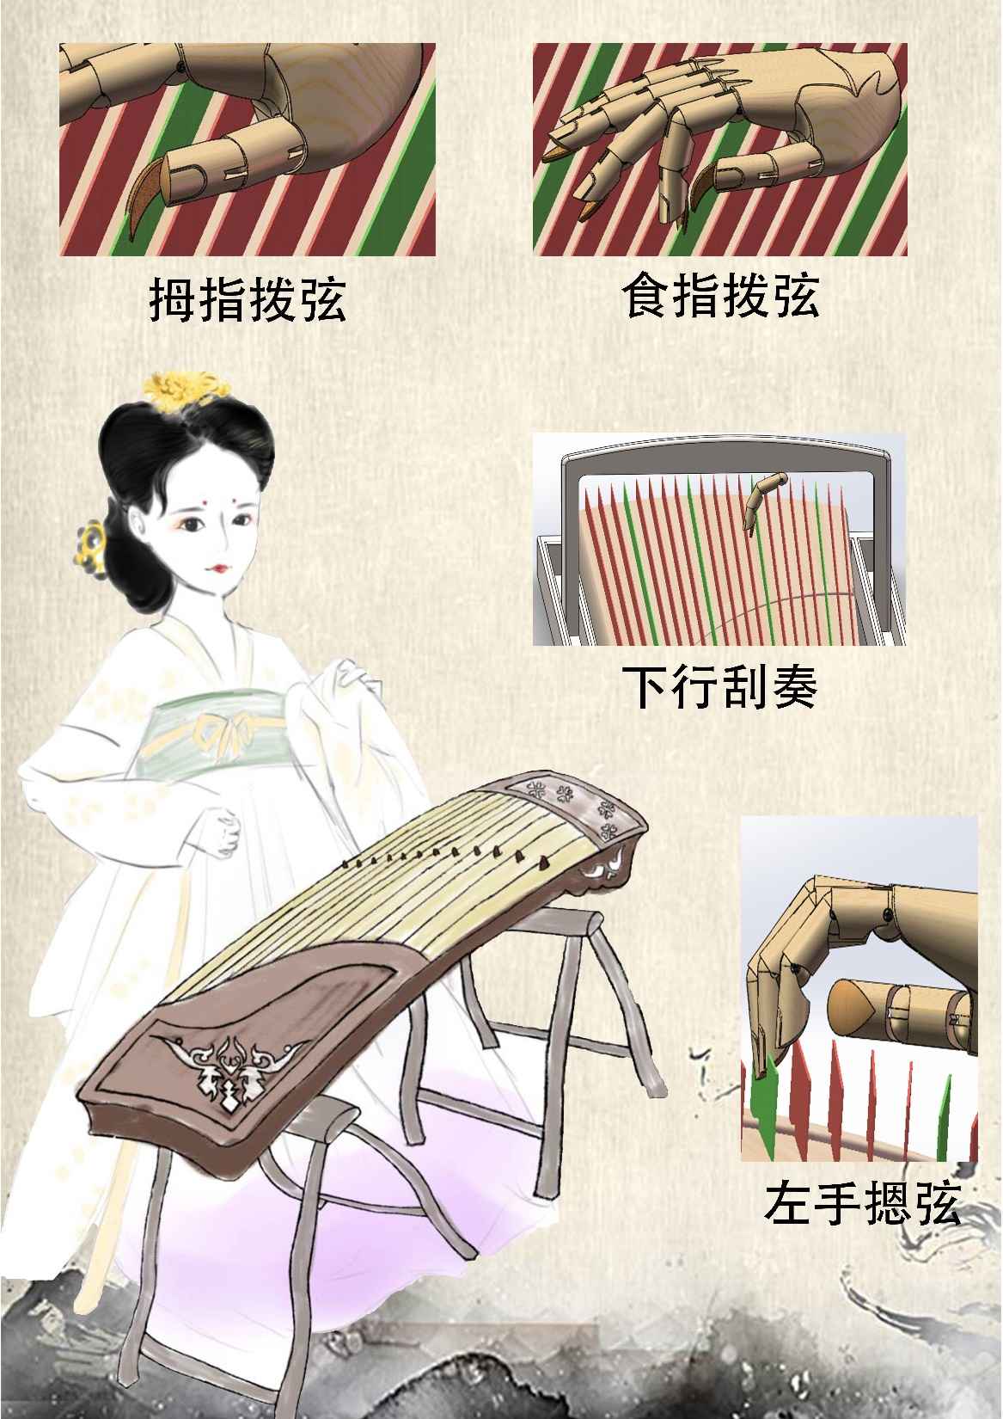

Slide 8
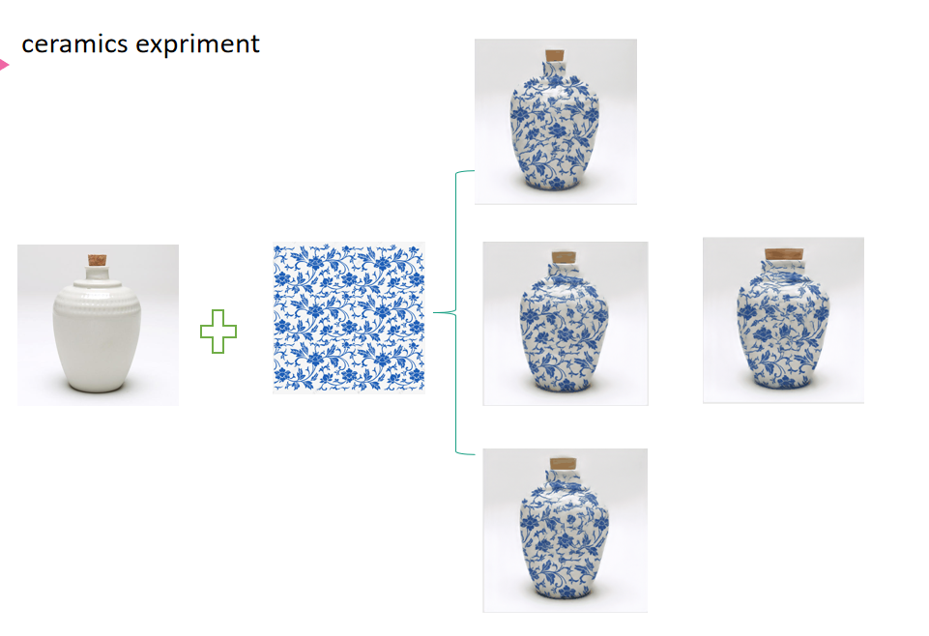

Slide 9
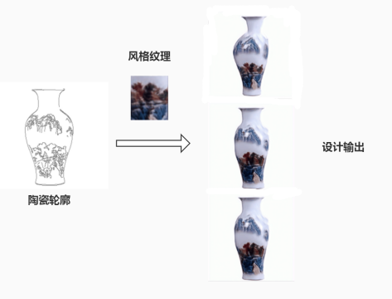

Slide 10
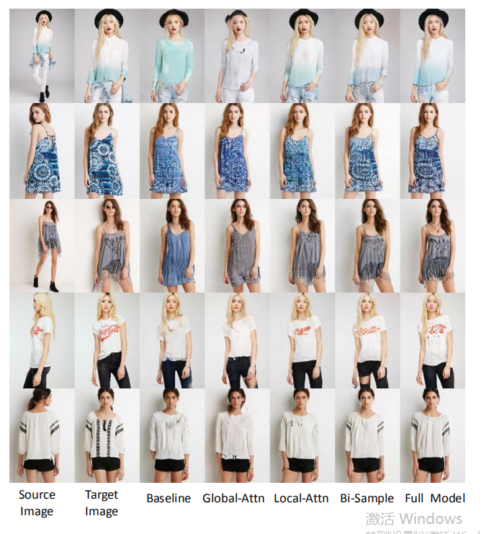
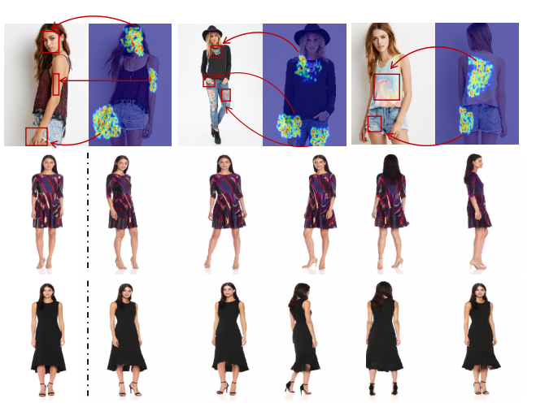
Deep Spatial Transformation for Pose-Guided
Person Image Generation and Animation

Slide 11
Overview of Characterisations
1.1 Long term goals
  What do we want to achieve with AI?
1.2 Inspirations
  How do we get machines to act intelligently?
1.3 Methodology employed
  Hack away or theorise
1.4 General tasks to achieve
  Reason, learn, discover, compete, communicate, …
1.5 - 1.8 Fine grained characterisations

Slide 12
1.1 Long Term Goals
1. Produce intelligent behaviour in machines
Why use computers at all?
  They can do things better than us
  Big calculations quickly and reliably
We do intelligent things
  So get computers to do intelligent things
Monty Hall problem
  Would a computer program get this wrong?

Slide 13
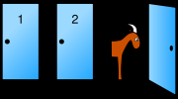
Monty Hall problem
The Monty Hall problem is a puzzle

Slide 14
Monty Hall problem
The Monty Hall problem is a puzzle involving probability loosely based on the American game show Let's Make a Deal. The name comes from the show's host, Monty Hall. A widely known statement of the problem appeared in a letter to Marilyn vos Savant's Ask Marilyn column in Parade (vos Savant 1990):
Suppose you're on a game show, and you're given the choice of three doors: Behind one door is a car; behind the others, goats. You pick a door, say No. 1, and the host, who knows what's behind the doors, opens another door, say No. 3, which has a goat. He then says to you, "Do you want to pick door No. 2?" Is it to your advantage to switch your choice?

Slide 15
Monty Hall problem …
Because there is no way for the player to know which of the two unopened doors is the winning door, many people assume that each door has an equal probability and conclude that switching does not matter.
However, as long as the host knows what is behind each door, always opens a door revealing a goat, and always makes the offer to switch, opening a losing door does not change the probability of 1/3 that the car is behind the player's initially chosen door. As there is only one other unopened door, the probability that this door conceals the car must be 2/3. It is therefore to the contestant's advantage, if they would rather have the car than the goat, to switch to door 2.

Slide 16
1.1 Long Term Goals
2. Understand human intelligence in society
  Aid to philosophy, psychology, cognitive science
Big question: what is intelligence?
  Smaller questions: language, attention, emotion
Example: The ELIZA program
  Helped to study Rogerian psychotherapy
How does society affect intelligence
  AI used to look into social behaviour

Slide 17
ELIZA program – computer therapist
ELIZA is a computer program by Joseph Weizenbaum, designed in 1966, which parodied a Rogerian therapist, largely by rephrasing many of the patient's statements as questions and posing them to the patient.
Thus, for example, the response to "My head hurts" might be "Why do you say your head hurts?" The response to "My mother hates me" might be "Who else in your family hates you?" ELIZA was named after Eliza Doolittle, a working-class character in George Bernard Shaw's play Pygmalion, who is taught to speak with an upper class accent.

Slide 18
1.1 Long Term Goals
3. Give birth to new life forms
Oldest question of all
  Meaning of life
One approach: model life in silicon
  Create “artificial” life forms (ALife)
Evolutionary algorithms
  (if it worked for life on planet earth…)
  Hope “life” will be an emergent property
  Can tame this for more utilitarian needs

Slide 19
1.1 Long Term Goals
4. Add to scientific knowledge
  Often ignored that AI produces big scientific questions
  Investigate intelligence, life, information
Example: complexity of algorithms
  NP=P?(Non-deterministic Polynomial)
Another example:
  What concepts can be learned by certain algorithms
  (computational learning theory)

Slide 20
1.2 Inspirations for AI
Major question:
  “How are we going to get a machine to
  act intelligently to perform complex tasks?”
Use what we have available:
  Logic, introspection, brains
  Evolution, planet earth
  Society, fast computers

Slide 21
1.2 Inspirations for AI
1. Logic
  Studied intensively within mathematics
  Gives a handle on how to reason intelligently
Example: automated reasoning
  Proving theorems using deduction
Advantage of logic:
  We can be very precise (formal) about our programs
Disadvantage of logic:
  Theoretically possible doesn’t mean practically achievable

Slide 22
1.2 Inspirations for AI
2. Introspection
  Humans are intelligent, aren’t they?
Heuristics to improve performance
  Rules of thumb derived from perceived human behaviour
Expert systems
  Implement the ways (rules) of the experts
  Example: MYCIN (blood disease diagnosis)
    Performed better than junior doctors
Introspection can be dangerous

Slide 23
MYCIN
Mycin was an early expert system developed over five or six years in the early 1970s at Stanford University; it was written in Lisp, by Edward Shortliffe under the direction of Bruce Buchanan and others; it derived from the earlier Dendral expert system, but considerably modified and extended the basic Dendral software.
This computer system was designed to diagnose infectious blood diseases and recommend antibiotics, with the dosage adjusted for patient's body weight — the name derived from the antibiotics themselves, as many antibiotics have the suffix "-mycin".

Slide 24
1.2 Inspirations for AI
3. Brains
  Our brains and senses are what give us intelligence
Neurologist tell us about:
  Networks of billions of neurons
Build artificial neural networks
  In hardware and software (mostly software now)
Build neural structures
  Interactions of layers of neural networks

Slide 25
Artificial Neural Networks
trying to mimic brain?
mathematical model
Dendrite树突
Axon轴突
Synapse
突触
Body

Slide 26
Neural Networks
Characterization
Topology
Transfer function
Training algorithm

Slide 27
Artificial Neural Networks
input layer
hidden layer
output layer
i
w_{ij}
j
w_{jk}
k
input
output
. . .
. . .
. . .
n
w_{nn}
n
n
input
output
neuron
w_{ij} to w_{nn} = weights

Slide 28
Neuron
Sum
Σ
Transfer
function
Input
to
neuron
Output from
neuron

Slide 29
Transfer functions
F(x)
F(x)
x
x
Step
Linear
S(x)
F(x)
x
x
Log-sigmoid
Tan-sigmoid

Slide 30
Neural Networks Topology
input layer
hidden layer
output layer
i
w_{ij}
j
k
i
w_{ij}
j
k
input
output
input
input
output
input
w_{nn}
w_{nn}
input
output
input
n
n
n
n
n
n
Feed-forward
Feed-back
neuron
w_{ij} to w_{nn} = weights
Recursive
Lateral feed-back
w_{ij}
w_{ij}
i
j
k
i
j
k
w_{nn}
w_{nn}
n
n
n
n
n
n

Slide 31
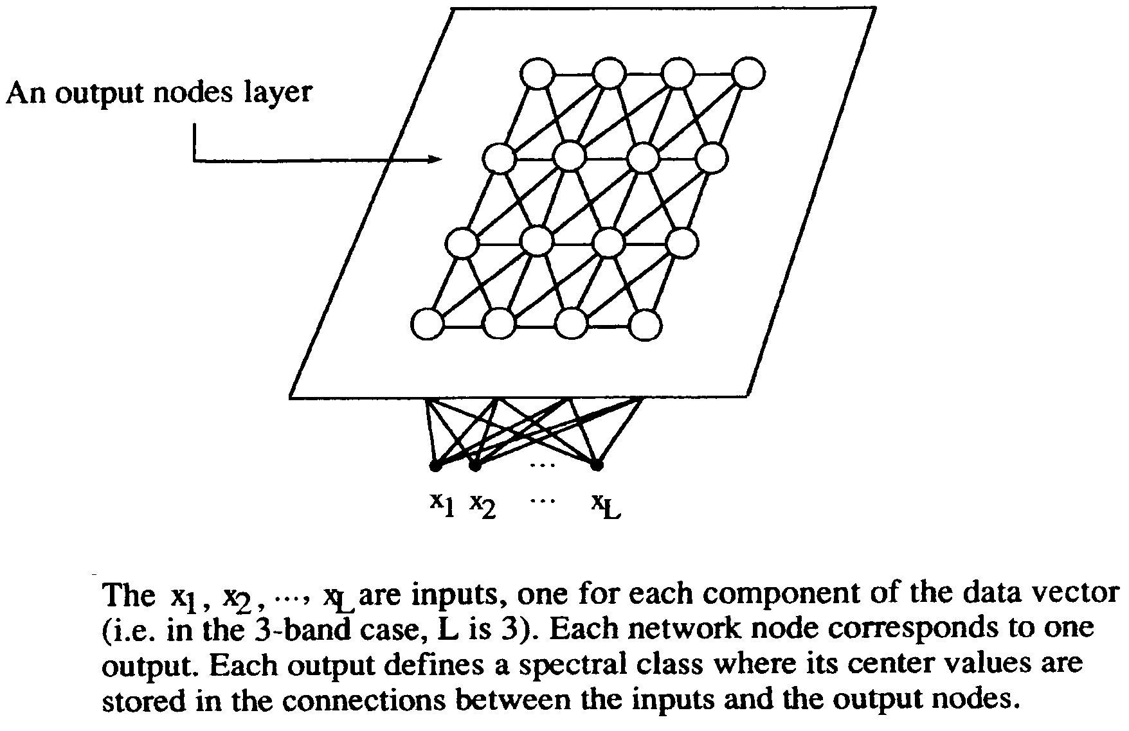
Competitive Learning Neural Networks

Slide 32
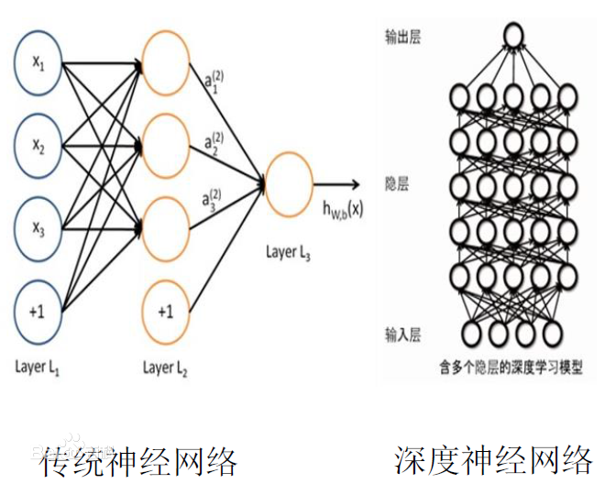

Slide 33
1.2 Inspirations for AI
4. Evolution
  Our brains evolved through natural selection
So, simulate the evolutionary process
  Simulate genes, mutation, inheritance, fitness, etc.
Genetic algorithms and genetic programming
  Used in machine learning (induction)
  Used in Artificial Life simulation

Slide 34
An Introduction to
Simple Genetic Algorithms

Slide 35
Genetic Algorithms
What Are Genetic Algorithms?
Genetic algorithms are search algorithms based on the mechanics of natural selection and natural genetics.

Slide 36
Genetic Algorithms
Terminology
The strings of artificial genetic systems are analogous to chromosomes(染色体) in biological systems. In natural systems, one or more chromosomes are combined to form the total genetic prescription for the construction and operation of some organism.

Slide 37
Genetic Algorithms
Terminology
genotype(基因型): the total genetic package in natural systems
phenotype(显型): the organism formed by the interaction of the total genetic package with its environment in natural systems
a structure: the total package of strings in artificial genetic systems. The structures decoded to form a particular parameter set, solution alternative, or point

Slide 38
Genetic Algorithms
Terminology
alleles(等位基因): chromosomes are composed of genes, which may take on some number of values
locus(所在地): the position of a gene. It is identified separately from the gene’s function in genetics .
Example for a particular gene :
an animal’s eye color gene, its locus, position 10, and its alleles values, blue eyes

Slide 39
Genetic Algorithms
Terminology
strings are composed of features or detectors, which take on different values. Features may be located at different positions on the string in artificial genetic search.

Slide 40
Genetic Algorithms
Comparison of Natural and GA Terminology
Natural | Genetic Algorithms
chromosome | string
gene | feature, character, or detector
allele | feature value
locus | string position
genotype | structure
phenotype | parameter set, alternative solution, a decoded structure
epistasis | nonlinearity

Slide 41
Genetic Algorithms
Different from more normal optimization and search procedures in four ways:
1. work with a coding of the parameter set, not the
parameters themselves, require the natural parameter set
of the optimization problem to be coded as a finite-length
string over some finite alphabet.
2. search from a population of points, not a single point.
3. use payoff (objective function) information, not derivatives
or other auxiliary knowledge.
4. use probabilistic transition rules, not deterministic rules.

Slide 42
Genetic Algorithms
Optimization problem:
Maximize the function on the integer interval [0, 31]
Traditional methods: we would be tempted to twiddle with the parameter x, turning it like the vertical hold knob on a television set, until we reached the highest objective function value.
GA: the first step of our optimization process is to code the parameter x as a finite-length string. (There are many ways to code the x parameter. At the moment, let’s consider an optimization problem where the coding comes a bit more naturally.)

Slide 43
Genetic Algorithms
A simple genetic algorithm is composed of three operators:
1. Reproduction
2. Crossover
3. Mutation

Slide 44
Genetic Algorithms
a simulation by hand
Maximize the function f(x) on the integer interval [0, 31]
code the decision variables of our problem as some
finite-length string.
For this problem, we will code the variable x simply as a
binary unsigned integer of length 5.

Slide 45
Genetic Algorithms
briefly review the notion of a binary integer
base 10:
base 10 of binary number 10,011
With a five-bit (binary digit) unsigned integer we can obtain numbers between 0 and 31 is 00000 - 11111

Slide 46



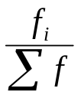

Genetic Algorithms
String No. | Initial Population (Randomly Generated) | x value (Unsigned Integer) |  |  | Expected count | Actual Count (from Roulette Wheel)
1 | 01101 | 13 | 169 | 0.14 | 0.58 | 1
2 | 11000 | 24 | 576 | 0.49 | 1.97 | 2
3 | 01000 | 8 | 64 | 0.06 | 0.22 | 0
4 | 10011 | 19 | 361 | 0.31 | 1.23 | 1
Sum |  |  | 1170 | 1.00 | 4.00 | 4.0
Average |  |  | 293 | 0.25 | 1.00 | 1.0
Max |  |  | 576 |  | 1.97 | 2.0

Slide 47
Genetic Algorithms
Mating Pool after reproduction (Cross Site Shown) | Mate (Randomly Selected) | Crossover Site (Randomly Selected) | New Population | x value | f (x) X^2
0 1 1 0 | 1 | 2 | 4 | 0 1 1 0 0 | 12 | 144
1 1 0 0 | 0 | 1 | 4 | 1 1 0 0 1 | 25 | 625
1 1 | 0 0 0 | 4 | 2 | 1 1 0 1 1 | 27 | 729
1 0 | 0 1 1 | 3 | 2 | 1 0 0 0 0 | 16 | 256
Sum |  |  |  |  | 1754
Average |  |  |  |  | 439
Max |  |  |  |  | 729

Slide 48
Genetic Algorithms
Reproduction operator:
1. Biased roulette wheel selection:
2. Tournament selection:
3. Elite selection:

Slide 49
Genetic Algorithms
Reproduction operator:
Biased roulette wheel selection: each current string in the population has a roulette wheel slot sized in proportion of its fitness.

Slide 50
Genetic Algorithms
(1)
14.4%
(4)
30.9%
(3) 5.5%
(2)
49.2%

Slide 51
Genetic Algorithms
Reproduction operator:
Tournament selection: Genotypes are randomly paired. The individual with the higher fitness “wins” and survives to the next generation. The lower fitness individual is discarded.
Elite selection: The genotypes are rank ordered according to their fitness. The bottom half of the ranking is discarded, the remaining doubled, leaving the best for the next generation.

Slide 52
Genetic Algorithms
Simple crossover proceeds in two steps:
1. strings are mated randomly, using coin tosses to pair off the happy couples
2. mated string couples cross over, using coin tosses to select the crossing sites.

Slide 53
Genetic Algorithms
Example:
Referring again to the table, random choice of mates has
selected the second string in the mating pool to be mated
with the first.
With a crossing site of 4, the two strings 01101 and 11000
cross and yield two new strings 01100 and 11001.
0 1 1 0 | 1 0 1 1 0 0
1 1 0 0 | 0 1 1 0 0 1
The remaining two strings in the mating pool are crossed at
site 2; the resulting strings may be checked in the table.

Slide 54
Genetic Algorithms
The last operator, mutation, is performed on a bit-by-bit basis.
We assume that the probability of mutation in this test is 0.001. With 20 transferred bit positions we should expected bits to undergo mutation during a given generation. Simulation of this process indicates that no bits undergo mutation for this probability value. As a result, no bit positions are changed from 0 to 1 or vice versa during this generation.

Slide 55
Genetic Algorithms (cont)
A simple genetic algorithm consists of four basic elements:
  1) generate populations of chromosomes,
  2) reproduction,
  3) crossover, and
  4) mutation.

Slide 56
Genetic Algorithms
Step 1: Define the strings (solutions) to be used.
Step 2: Start creating an initial population of possible strings.
Step 3: Evaluate each string by applying a fitness function.
Step 4: Search for new strings by exchanging genetic materials (i.e. crossover and mutation).
Step 5: Select the more promising strings (reproduction).
Step 6: Check for terminating conditions. If no termination condition is met, return to step 3.

Slide 57
A simulation by hand
Maximize the function f(x) = x² on the integer interval [0, 31]
code the decision variables of our problem as some
finite-length string.
For this problem, we will code the variable x simply as a binary unsigned integer of length 5.

Slide 58
Genetic Algorithms …
Step 1: Define the strings (solutions) to be used randomly.
The solution is guaranteed in the range of between 0 and 31. To encode any solution needs 5-bit length.

Slide 59
Genetic Algorithms …
Step 2: Start creating an initial population of possible strings randomly.
01101
11000
01000
10011

Slide 60
Genetic Algorithms …
Step 3: Evaluate each string by applying a fitness function.
A possible fitness function is x² (integer). Can we use 1/x²?
01101 fitness value 121
11000 “ 576
01000 “ 64
10011 “ 361

Slide 61
Genetic Algorithms …
Step 4: Search for new strings by exchanging genetic materials (i.e. crossover and mutation).
Assume that Tournament selection (strings are randomly paired) is used.
011|01 crossover (1 & 2) 01100
110|00 11001
01|000 “ (3 & 4) 01011
10|011 10000

Slide 62
Genetic Algorithms …
Step 4: Search for new strings by exchanging genetic materials (i.e. crossover and mutation).
01100 Mutation 01110
11001 “ 11101
01011 11011
10000 10001

Slide 63
Genetic Algorithms …
Step 5: Select the more promising strings (reproduction).
Assume that Ellite selection (strings with good fitness are survived) is used.
01110 fitness value 196
11101 “ 841
11011 “ 729
10001 “ 289

Slide 64
Genetic Algorithms …
Step 5: Select the more promising strings (reproduction).
Select two best strings and randomly generate another two strings to maintain the same population.
11101 (Best fitness 841)
11011 (second best fitness 729)
01000 new string
00100 new string

Slide 65
Genetic Algorithms …
Step 6: Check for terminating conditions. If no termination condition is met, return to step 3.
If the iteration (number of generations) is termined, the string 11101 would be the solution.
Otherwise, the algorithm continues.

Slide 66
1.2 Inspirations for AI
5. Evolution on Earth
  We evolved to survive in a dynamic environment
Moving around and avoiding objects
  More intelligent than playing chess
AI should be embedded in robotics
  Sensors (vision, etc.), locomotion, planning
  Hope that intelligent behaviour emerges
Behaviour based robotics
  Start with insect like behaviour

Slide 67
1.2 Inspirations for AI
6. Society
  Humans interact to achieve tasks requiring intelligence
  Can draw on group/crowd psychology
Software should therefore
  Cooperate and compete to achieve tasks
Multi-agent systems
  Split tasks into sub-tasks
  Autonomous agents interact to achieve their subtask

Slide 68
1.2 Inspirations for AI
7. Computer science
  Computers and operating systems got very fast
Allows us to write intelligent programs
  In “bad” ways: using brute force
Doing massive searches
  Rather than reasoning intelligently
Example: computer chess
  Some people say that this “isn’t AI”
  Drew McDermott disagrees

Slide 69
1.3 Methodologies
“Neat” approach
  Ground programs in mathematical rigour
  Use logic and possibly prove things about programs
“Scruffy” approach
  Write programs and test empirically
  See which methods work computationally
“Smart casual”: use both approaches
  See AI as an empirical science and technology
  Needs theoretical development and testing

Slide 70
1.4 General Tasks
AI is often presented as
  A set of problem solving techniques
  Most tasks can be shoe-horned into a “problem” spec.
Some problems attacked with AI techniques:
  Getting a program to reason rationally
  Getting a program to learn and discover
  Getting a program to compete
  Getting a program to communicate
  Getting a program to exhibit signs of life
  Getting a robot to move about in the real world

Slide 71
1.5 Generic Techniques
Automated Reasoning
  Resolution, proof planning, Davis-Putnam, CSPs
Machine Learning
  Neural nets, ILP, decision tree learning
Natural language processing
  N-grams, parsing, grammar learning
Robotics
  Planning, edge detection, cell decomposition
Evolutionary approaches
  Crossover, mutation, selection

Slide 72
1.6 Representation/Languages
AI catchphrase
  “representation, representation, representation”
Some general schemes
  Predicate logic, higher order logic
  Frames, production rules
  Semantic networks, neural nets, Bayesian nets
Some AI languages developed
  Prolog, LISP, ML
  (Perl, C++, Java, etc. also very much used)

Slide 73
1.7 Application Areas
Applications which AI has been used for:
  Art, astronomy, bioinformatics, engineering,
  Finance, fraud detection, law, mathematics,
  Military, music, story writing, telecommunications
  Transportation, tutoring, video games, web search
  And many more…
AI takes as much as it gives to domains
  AI is not a slave to other applications
  It benefits from input from other domains

Slide 74
1.8 Final Products
Some AI programs/robots are well developed
Example software:
  Otter (theorem prover, succesor to EQP)
  Progol (machine learning)
  Eliza (psychotherapy!!)
Example hardware:
  SHAKEY (very old now)
  Rodney Brooks’ vacuum cleaner
  Museum tour guide

Slide 75


Questions & Suggestions?
The End

